Slide 1
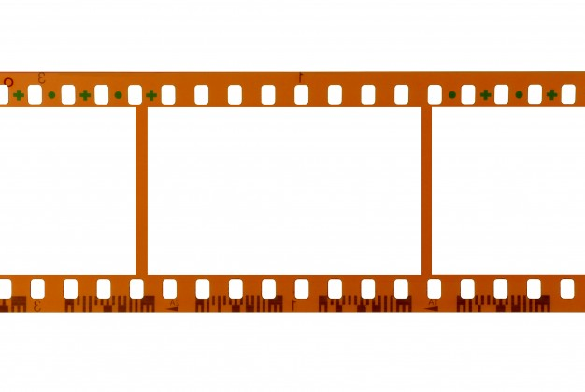
35mm film strip – 24 frames per sec, sound on side perforation

Slide 2
Aspect Ratio
Aspect ratio is a proportional relationship between an image's width and height
Academy Ratio (Hollywood, 1930s onwards): 4:3/1.33:1
Europe – Stnd. Ratio: 16:9 (1.77:1)
The most common ratios for modern films are 1.85:1 and 2.39:1

Slide 3
Things Change
1.77:1 is now industry standard for digital TV, and therefore, cinema as well
Panvision Images – IMAX, Cinemascope etc. – 2.35:1, even 2.59:1
People still shoot 1.33:1 sometimes

Slide 4

4:3/1.33:1

Slide 5
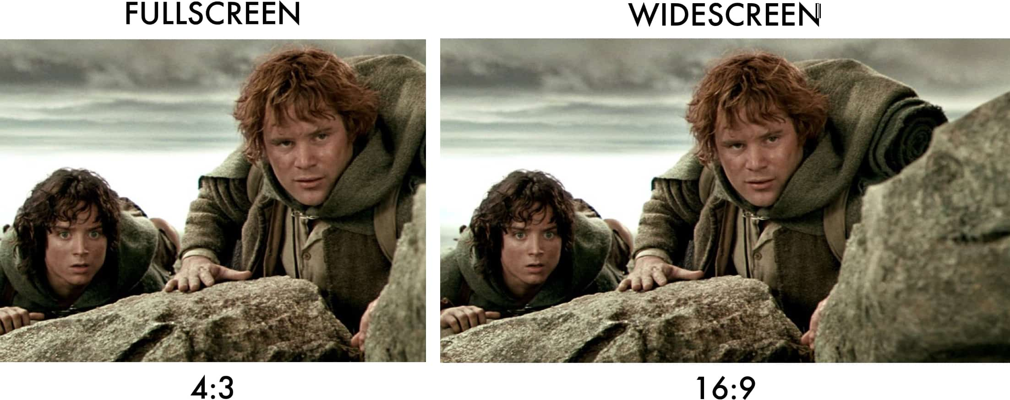
4:3/1.33 vs. 16:9/1.77:1

Slide 6
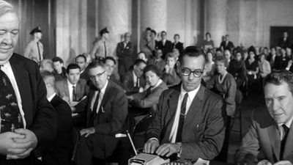
Another example – Cropped to 4:3

Slide 7
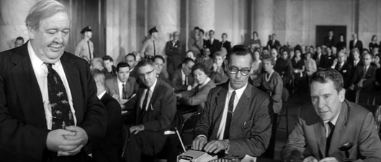
16:9

Slide 8

Big is spectacular –2.35:1

Slide 9

2.35:1

Slide 10
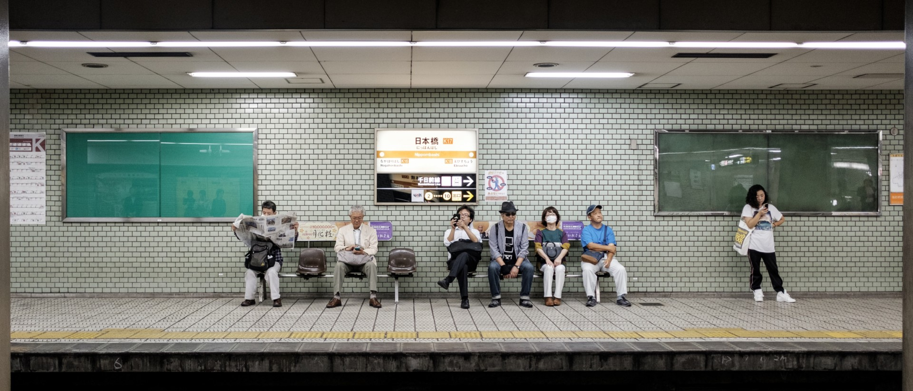
That’s not its only purpose

Slide 11
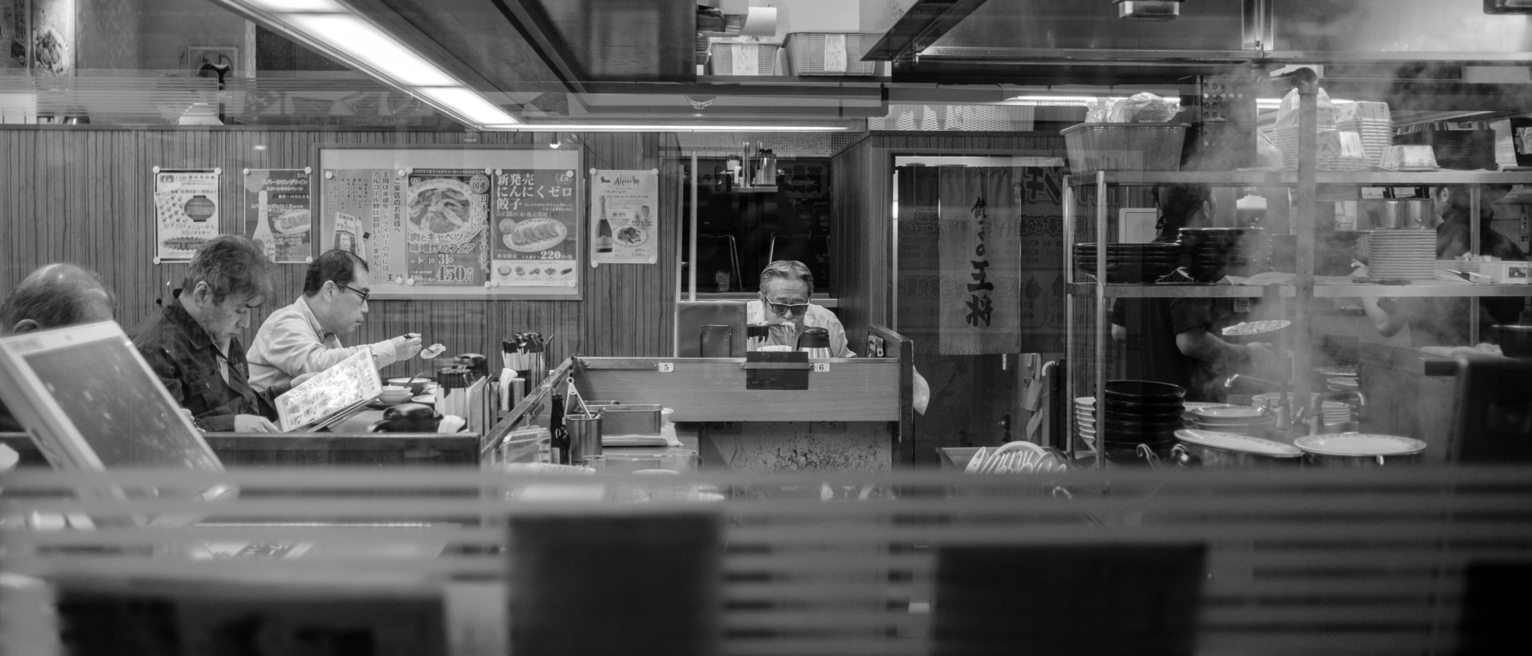
Details, isolation

Slide 12
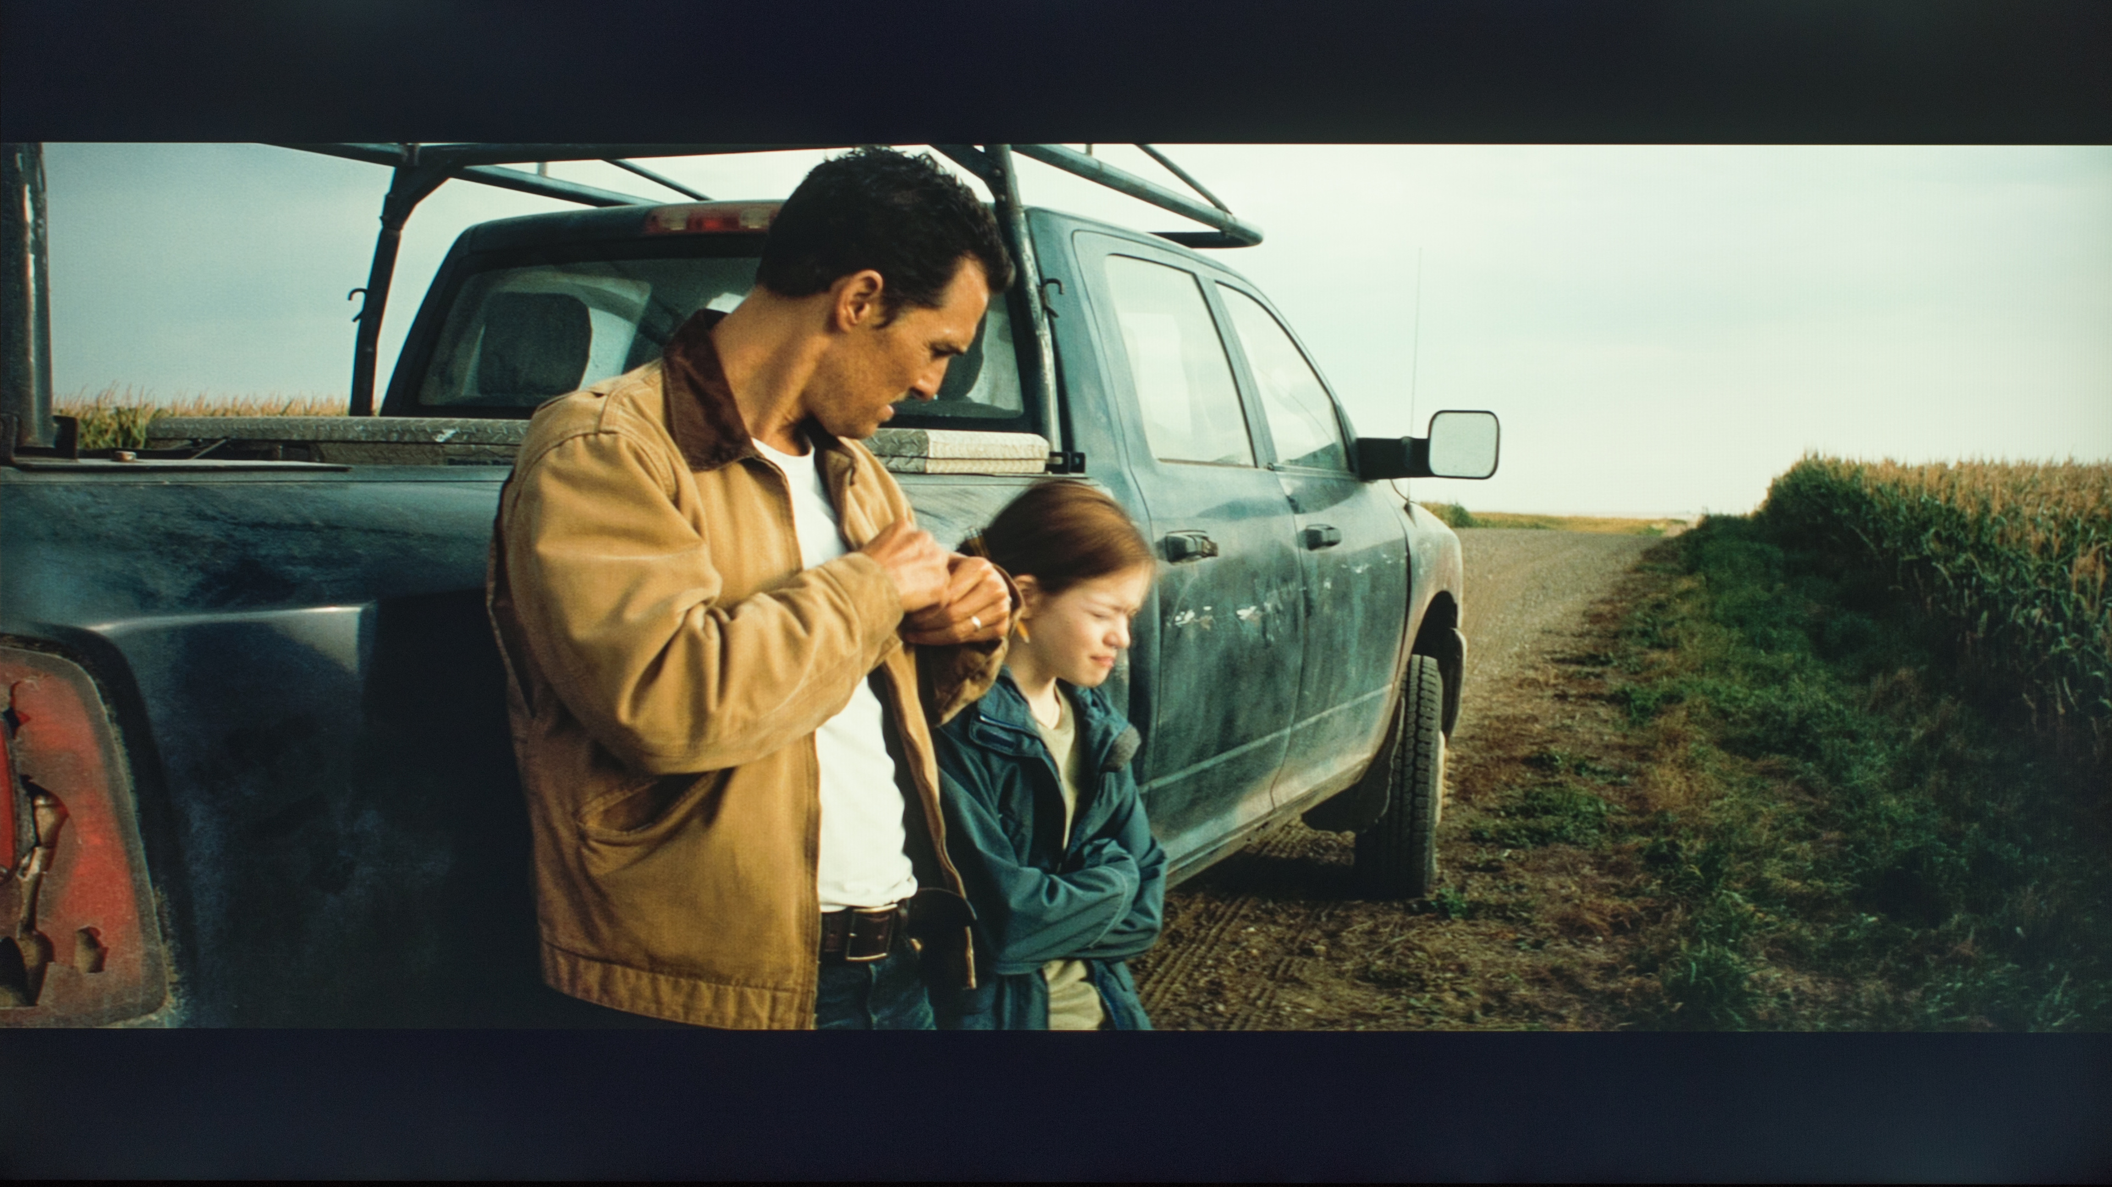
Mid-shot, 2.35:1, letterboxed(black rim on sides) to fit TV screens

